Slide 1
Examples for lectures
Mobile Communications 2019
Notes:
1

Slide 2
Question 1
Explain the physical mechanism that results in small scale fading environment. What effect does this have on the BER vs. SNR for a digital transmission?
Small scale fading:
occurs in a distance of a few wavelengths
varies by 30-40dB
result of constructive and destructive summation of multipath components
Deep fades result in low instantaneous SNR
High BER

Slide 3
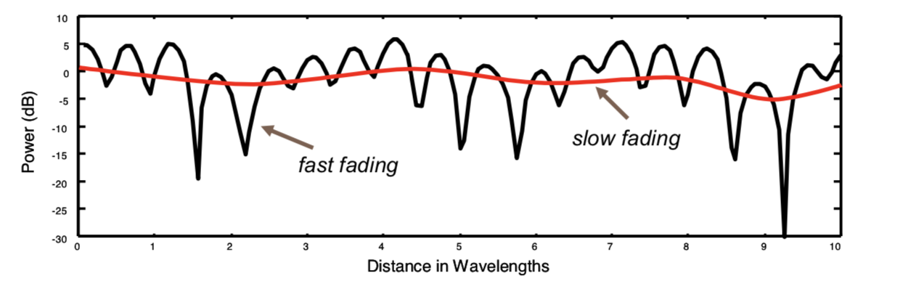
Questions 2-3
In which type of fading we have significant amplitude and phase changes?
Slow fading
Fast fading
In which scenario, all multipaths have approximately the same amplitude?
Rayleigh
Rician

Slide 4
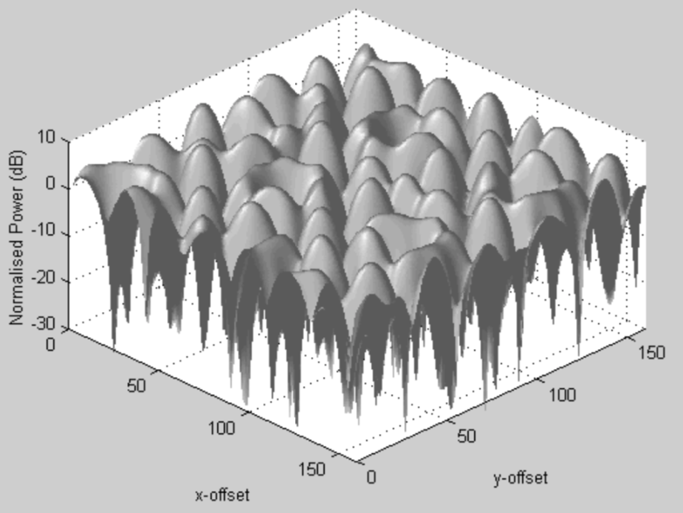
Rayleigh fading over rectangular area
Fading over a rectangular area (i.e. room)
Small movements in space result in changes in the envelope (amplitude)
Deep fades can be 40dB below the signal peaks

Slide 5
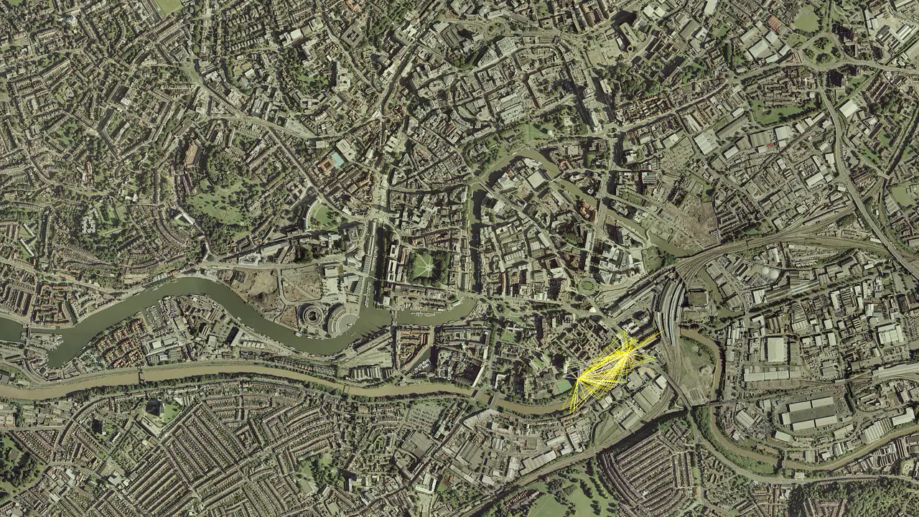

Slide 6
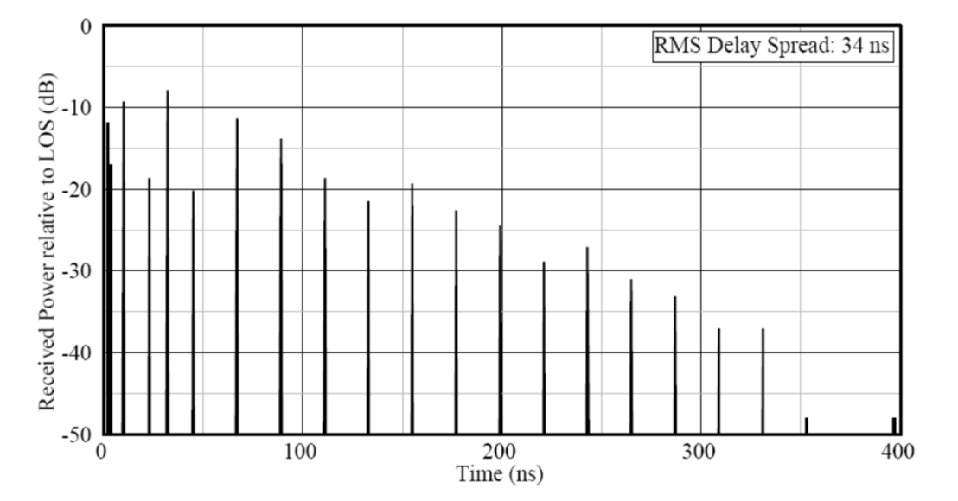
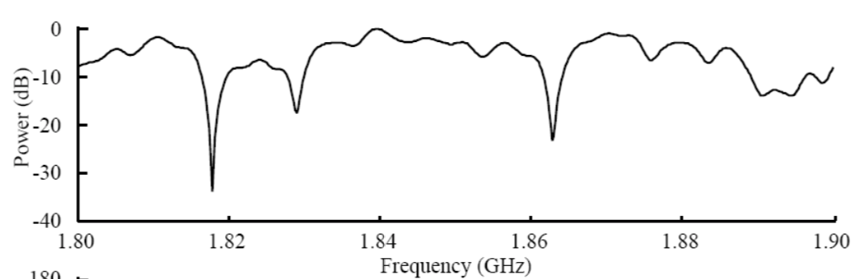
Power Delay Profile
Theoretic indoor PDP shown
Usually, the first rays to arrive, have the largest amplitude (shortest distance)
magnitude tends to fall away as the time delay increases (due to path loss, reflection/diffraction loss)
Frequency selective channel

Slide 7

Wideband System
Channel bandwidth is far in excess of the channel’s coherence bandwidth. Allows higher bandwidth and faster communication.
Narrowband System
Channel bandwidth is less than the channel’s coherence bandwidth.

Slide 8
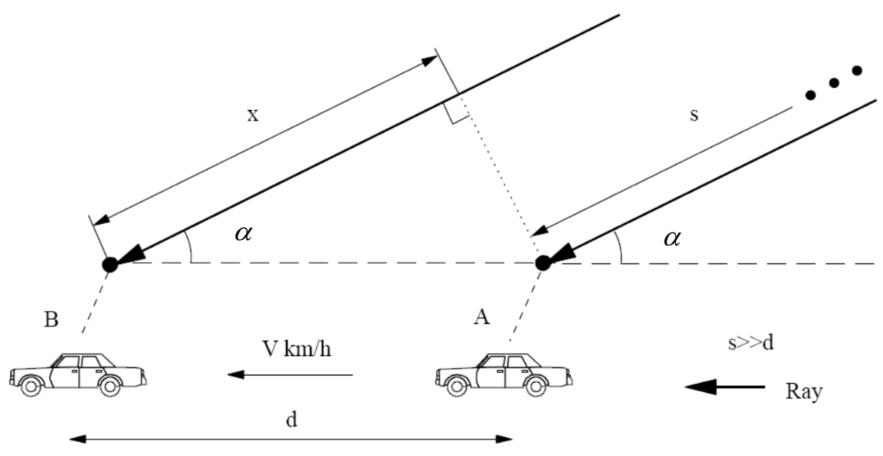
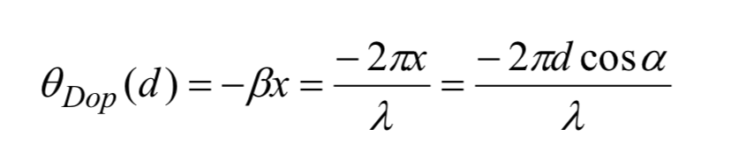
Derivation of Doppler Shift (1)
At point B the radio path back to the transmitting
source (vehicle moving away from basestation) is extended to length by distance x
By basic geometry, considering the triangle:
$$x=dcosa$$
Phase change for a single path:
$$x$$
$$a$$
$d$
Terminal is moving
away from BS
$$x=dcosa$$
Notes:
hypotenus

Slide 9
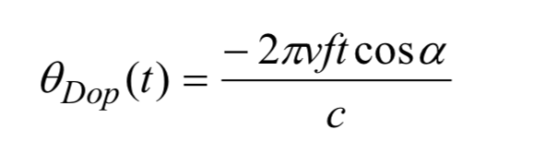
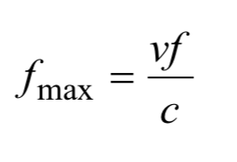
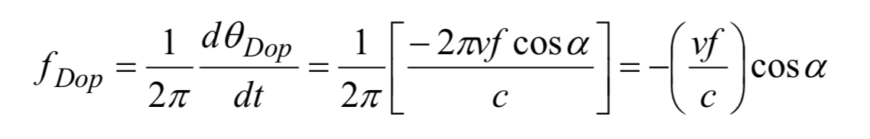
Derivation of Doppler Shift (2)
Assuming:
constant $v=\frac{d}{t},$i.e. $d=vt$
$c=fλ,$ i.e. $λ=\frac{c}{f}$
The resulting Frequency Shift/Doppler frequency (=rate of phase change due to movement):

Slide 10
Doppler frequency – Example
A vehicle is moving, with a speed of 80km/h, from point A to point B, driving away from the basestation, operating at 900MHz, which is at a distance of 2.5km. The distance that the vehicle has moved from point A to point B is 200m. We assume only one multipath with an angle of arrival of 0.52rads, and zero initial phase. Calculate the doppler frequency.

Slide 11
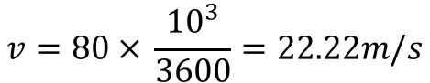
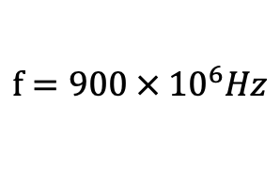
Doppler frequency – Example
A vehicle is moving, with a speed of 80km/h, from point A to point B, driving away from the basestation, operating at 900MHz, which is at a distance of 2.5km. The distance that the vehicle has moved from point A to point B is 200m. We assume only one multipath with an angle of arrival of 0.52rads , and zero initial phase. Calculate the doppler frequency.
$$v=80 × \frac{{10}^{3}}{3600}=22.22m/s$$
$$f=900 × {10}^{6}Hz$$
$$f_{DOP}=−\frac{22.22×900×{10}^{6}}{3×{10}^{8}}\cos\left(0.52\right)=−66.66×0.86=−57.327Hz$$

